Slide 1
Web Technologies
HTML Forms

Slide 2
HTML Forms
HTML Forms are required when you want to collect some data from the site visitor. For example, during user registration you would like to collect information such as name, email address, credit card, etc.
The HTML <form> element defines a form that is used to collect user input.
The <form> element is a container for different types of input elements, such as: text fields, checkboxes, radio buttons, submit buttons, etc.
<form action=“Home.php" method="post">
...
</form>
The most common attribute of <form> are action and method.
The action attribute contains the URL to which information included within the form will be sent for processing by the server.
The method attribute is the HTTP method browsers should use to submit the form data.
Both action and method attributes are related to submitting and processing data.

Slide 3
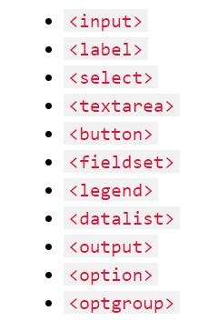
The HTML <form> Elements
The HTML <form> element can contain one or more of the following form elements:

Slide 4
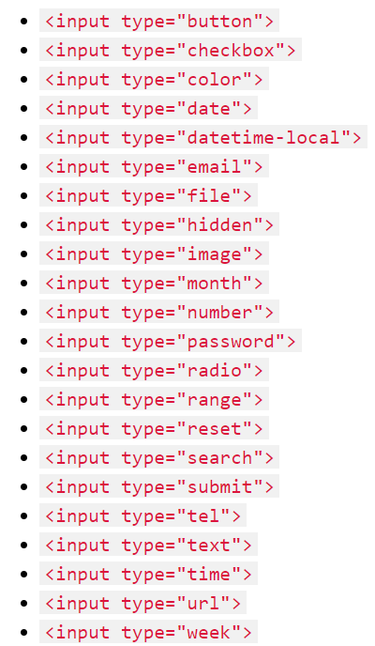
The <input> Element
The HTML <input> element is the most used form element.
An <input> element can be displayed in many ways, depending on the type attribute.

Slide 5
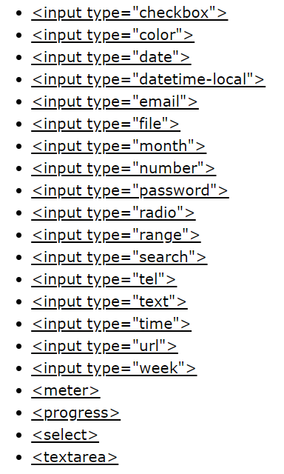
The <label> Element
The <label> tag defines a label for many form elements. Following is the list of elements that support label elements
The <label> element is useful for screen-reader users, because the screen-reader will read out loud the label when the user focus on the input element.
The <label> element also help users who have difficulty clicking on very small regions (such as radio buttons or checkboxes) - because when the user clicks the text within the <label> element, it toggles the radio button/checkbox.
The for attribute of the <label> tag should be equal to the id attribute of the <input> element to bind them together.

Slide 6
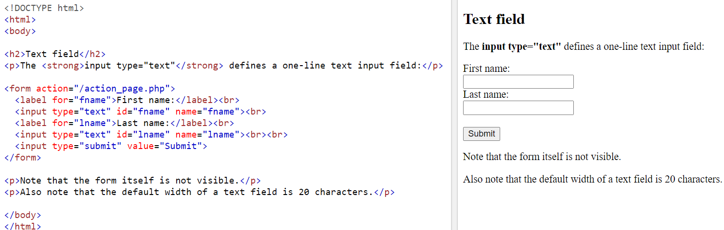
Input Type Text
<input type="text"> defines a single-line text input field.
The default width of the text field is 20 characters.

Slide 7
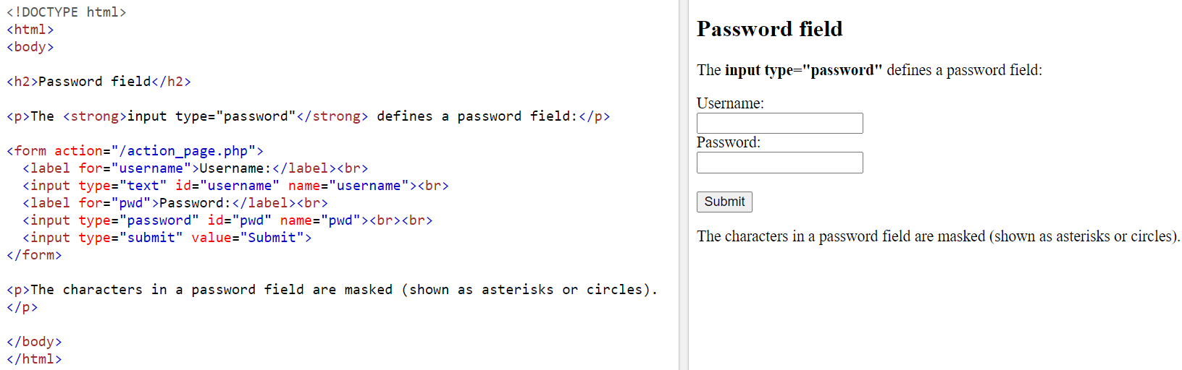
Input Type Password
The <input type="password"> defines a password field (characters are masked).

Slide 8
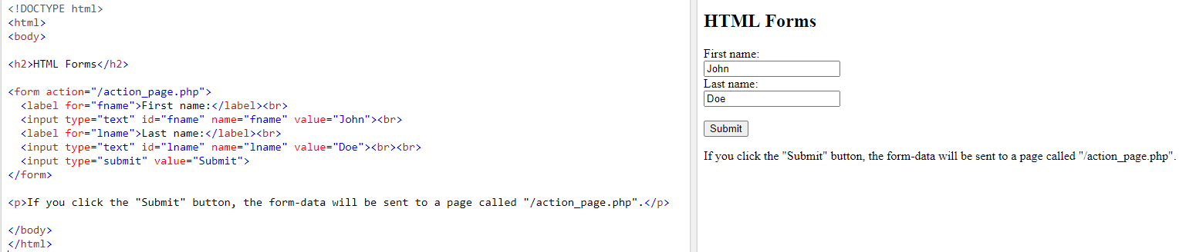
The Submit Button
The <input type="submit"> defines a button for submitting the form data to a form-handler.
The form-handler is typically a file on the server with a script for processing input data.
The form-handler is specified in the form's action attribute.

Slide 9
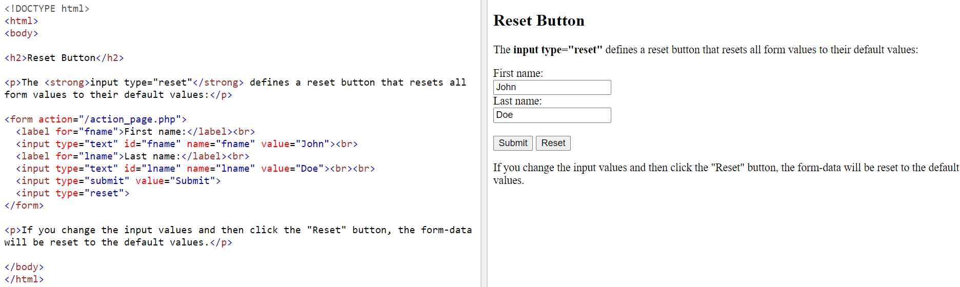
Input Type Reset
<input type="reset"> defines a reset button that will reset all form values to their default values:

Slide 10
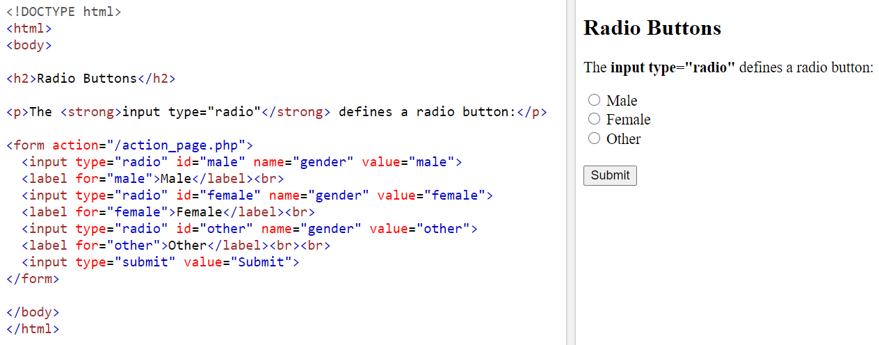
Input Type Radio
<input type="radio"> defines a radio button.
Radio buttons are normally presented in radio groups (a collection of radio buttons describing a set of related options). Only one radio button in a group can be selected at the same time.
The radio group must share the same name (the value of the name attribute) to be treated as a group. Once the radio group is created, selecting any radio button in that group automatically deselects any other selected radio button in the same group. You can have as many radio groups on a page as you want, as long as each group has its own name.
The value attribute defines the unique value associated with each radio button. The value is not shown to the user but is the value that is sent to the server on "submit" to identify which radio button that was selected.

Slide 11
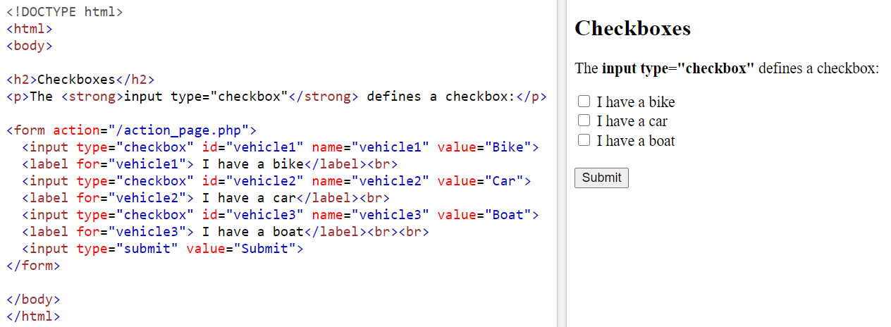
Input Type Checkbox
<input type="checkbox"> defines a checkbox.
Checkboxes let a user select ZERO or MORE options of a limited number of choices.
The checkbox is shown as a square box that is ticked (checked) when activated.
Checkboxes are used to let a user select one or more options of a limited number of choices.

Slide 12
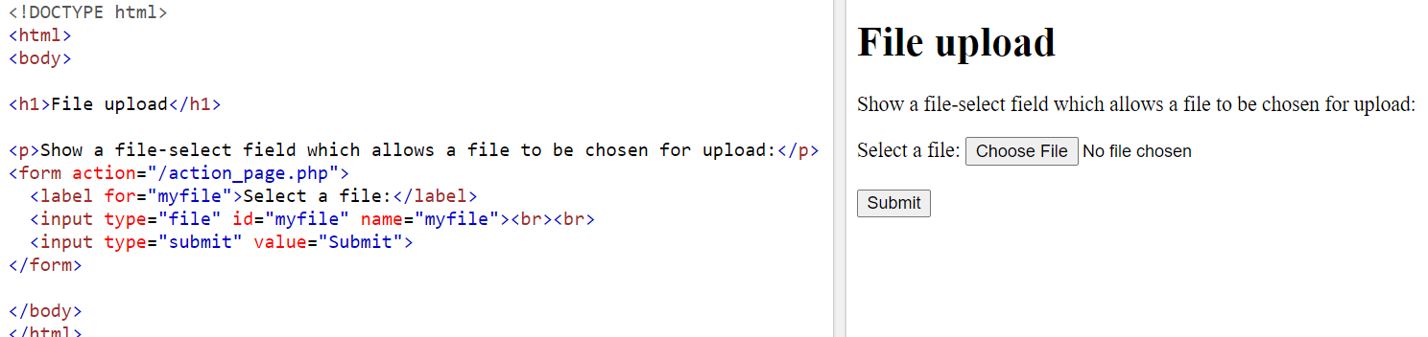
Input Type File
The <input type="file"> defines a file-select field and a "Browse" button for file uploads.
To define a file-select field that allows multiple files to be selected, add the "multiple" attribute.

Slide 13
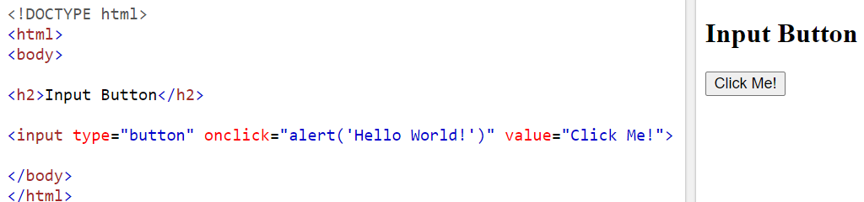
Input Type Button
The <input type="button"> defines a clickable button (mostly used with a JavaScript to activate a script).

Slide 14
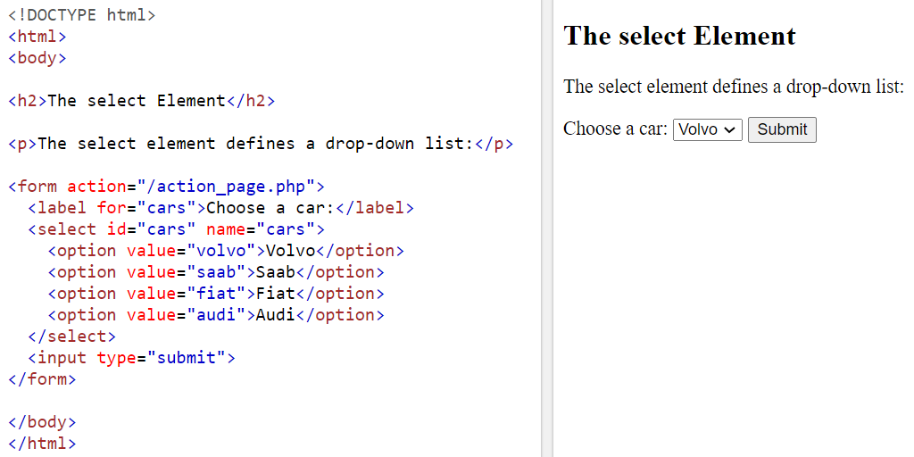
The <select> Element
The <select> element defines a drop-down list. The <option> elements defines an option that can be selected. By default, the first item in the drop-down list is selected.
Use the size attribute to specify the number of visible values.
To define a pre-selected option, add the selected attribute to the option.
Use the multiple attribute to allow the user to select more than one value:

Slide 15
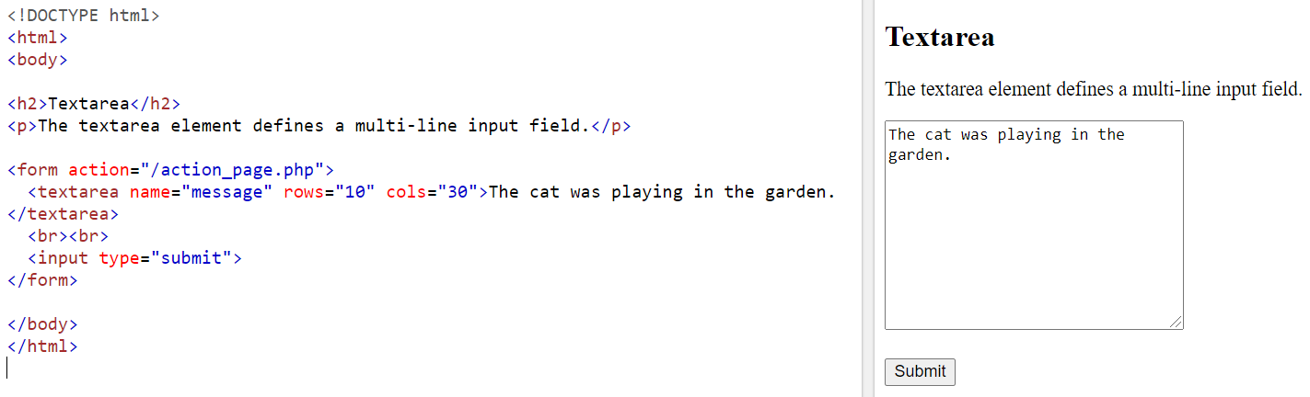
The <textarea> Element
The <textarea> element defines a multi-line input field (a text area).
The rows attribute specifies the visible number of lines in a text area.
The cols attribute specifies the visible width of a text area.
You can also define the size of the text area by using CSS.

Slide 16
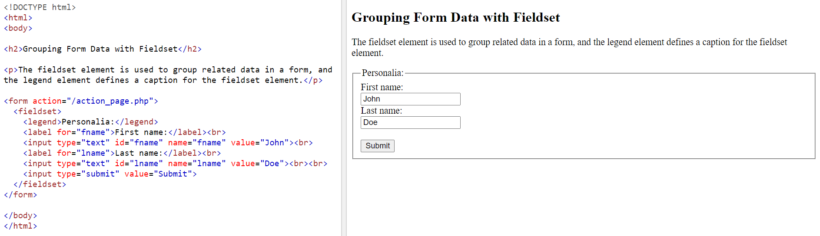
The <fieldset> and <legend> Elements
The <fieldset> element is used to group related data in a form.
The <legend> element defines a caption for the <fieldset> element.

Slide 17
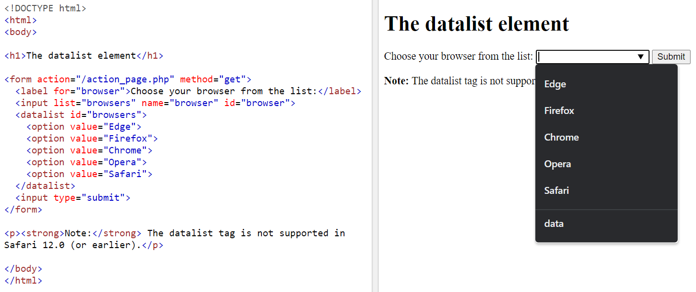
The <datalist> Element
The <datalist> element specifies a list of pre-defined options for an <input> element.
Users will see a drop-down list of the pre-defined options as they input data.
The list attribute of the <input> element, must refer to the id attribute of the <datalist> element.

Slide 18
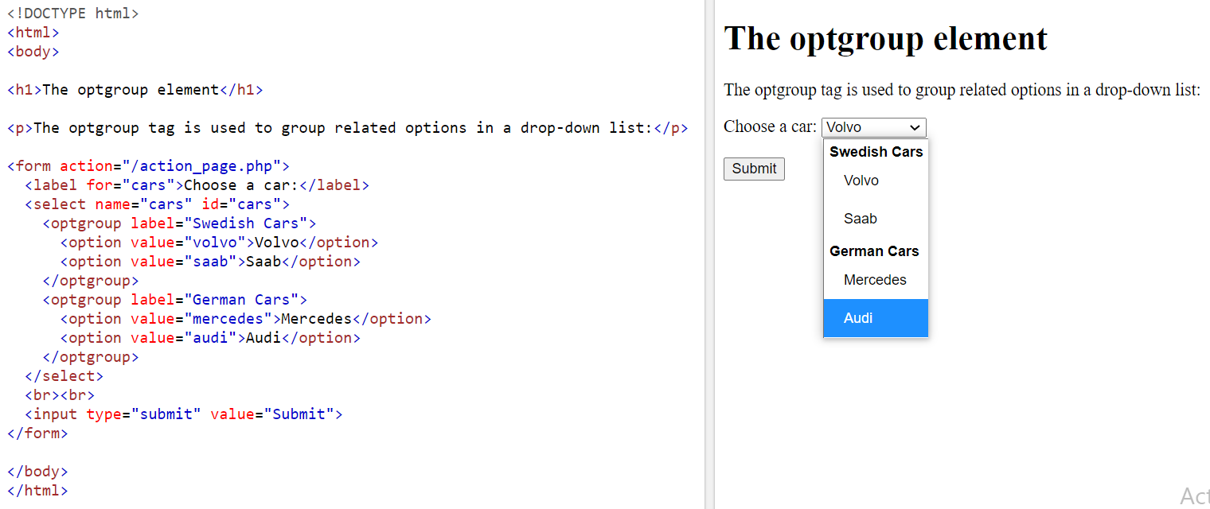
HTML <optgroup> Tag
The <optgroup> tag is used to group related options in a <select> element (drop-down list).

Slide 19
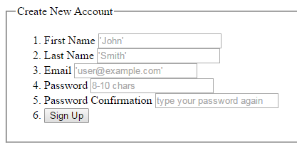
A sample Form

